Slide 1
Final Project - Awesome Deep
Meng Zhixiang
CSCI 3290 Computational Photography

Slide 2
Super Resolution
Objective:
To increase the resolution of a single image
Generate Training Data
Build NN Model
Training
Testing

Slide 3
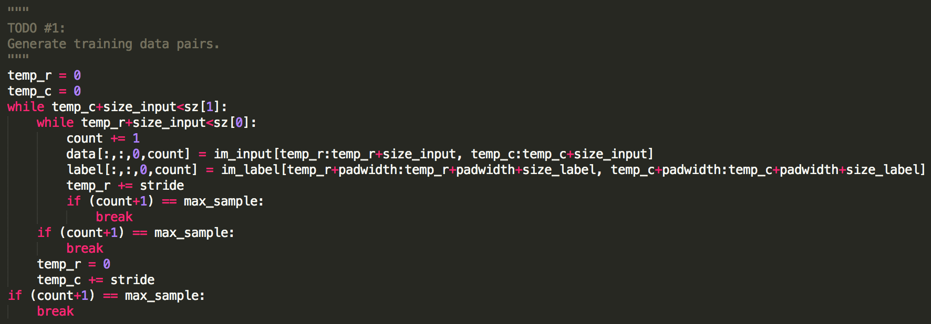
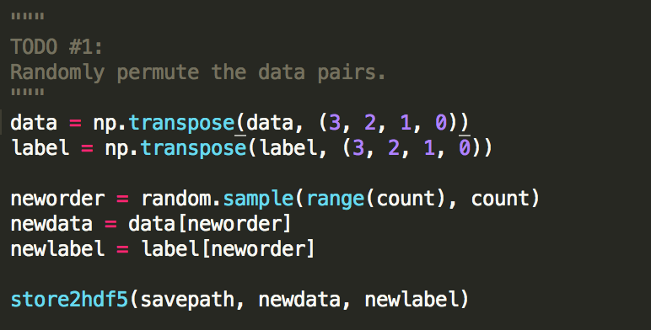
Generate Training Data

Slide 4
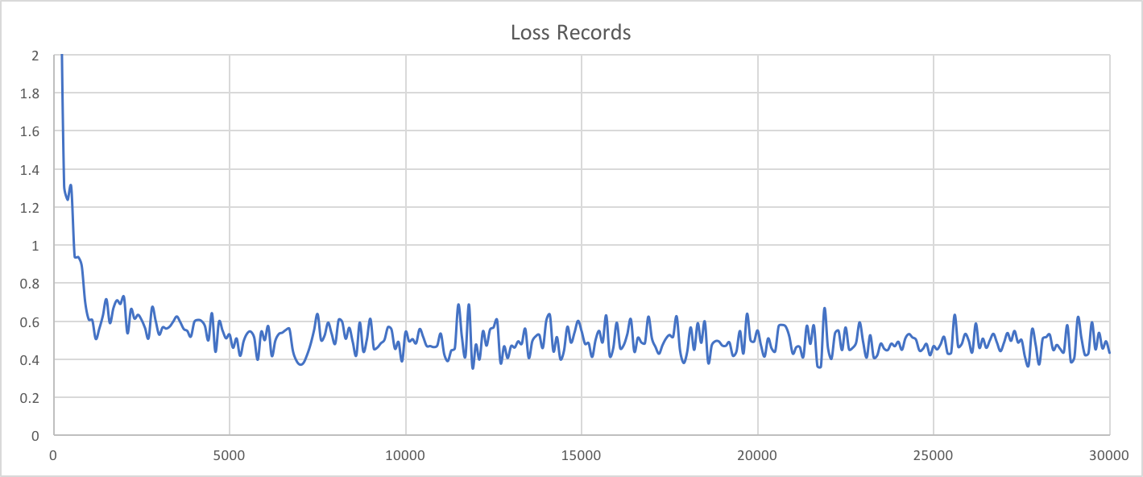
Results: Loss

Slide 5
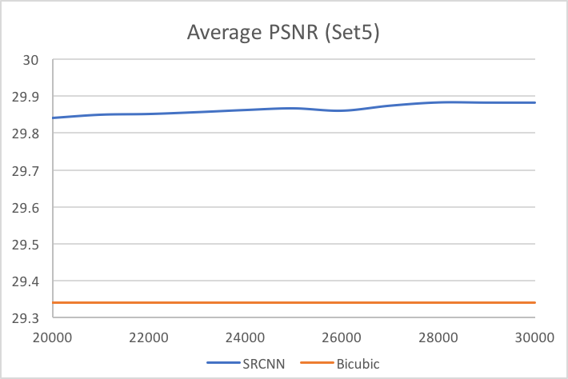
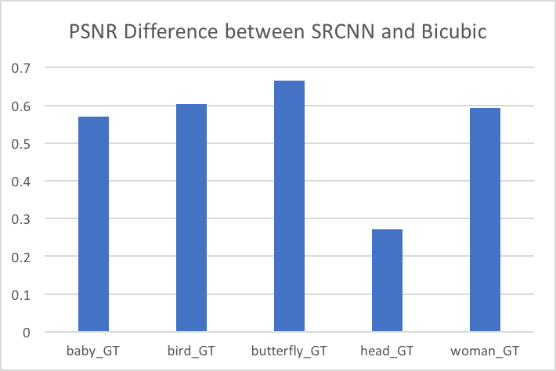
Results: PSNR (Set5)
 | baby_GT | bird_GT | butterfly_GT | head_GT | woman_GT
SRCNN | 33.34 | 32.29 | 23.48 | 32.27 | 28.03
Bicubic | 32.77 | 31.68 | 22.82 | 32.00 | 27.44

Slide 6
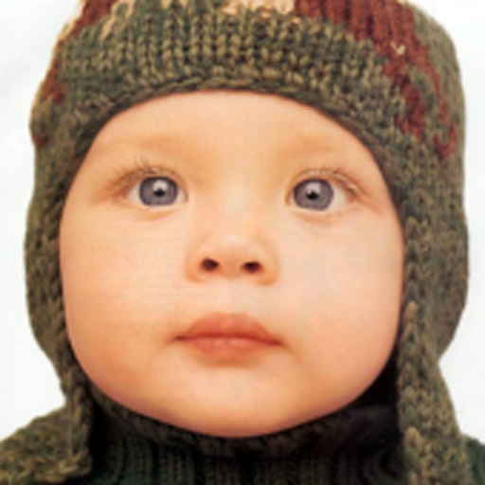

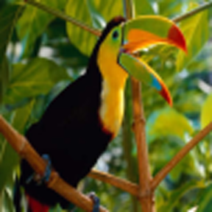








Slide 7
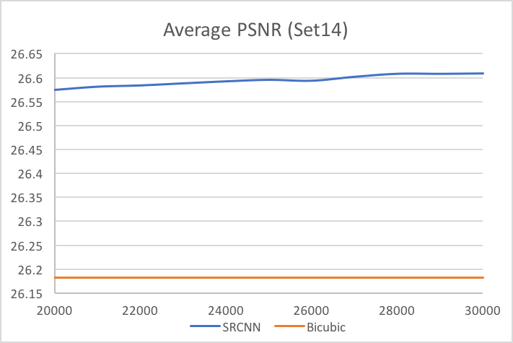
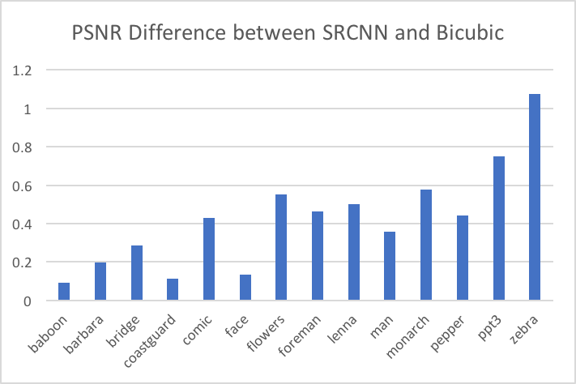
Results: PSNR (Set14)
 | baboon | barbara | bridge | coastguard | comic | face | flowers | foreman | lenna | man | monarch | pepper | ppt3 | zebra
SRCNN | 21.62 | 25.21 | 24.57 | 25.32 | 22.28 | 32.11 | 26.84 | 29.11 | 30.54 | 26.15 | 28.92 | 30.12 | 23.16 | 26.59
Bicubic | 21.53 | 25.01 | 24.29 | 25.21 | 21.85 | 31.97 | 26.29 | 28.65 | 30.04 | 25.79 | 28.34 | 29.68 | 22.40 | 25.51

Slide 8




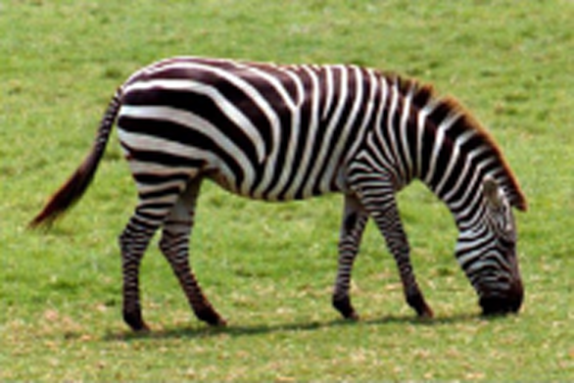


Slide 9


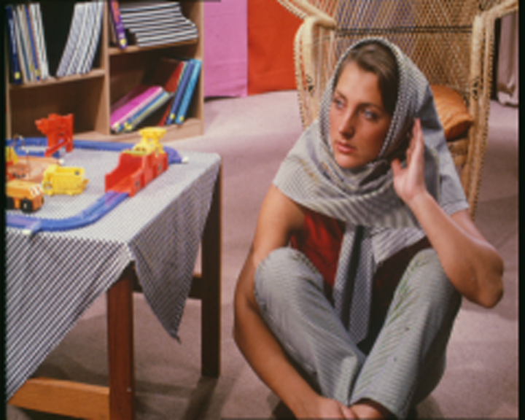

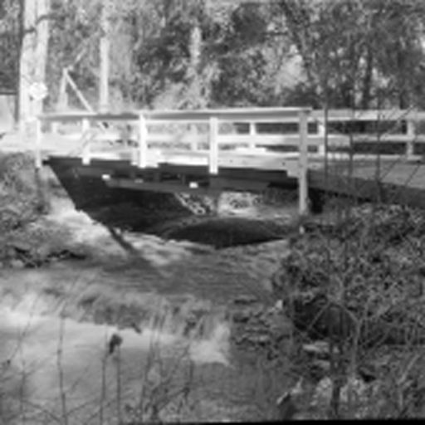

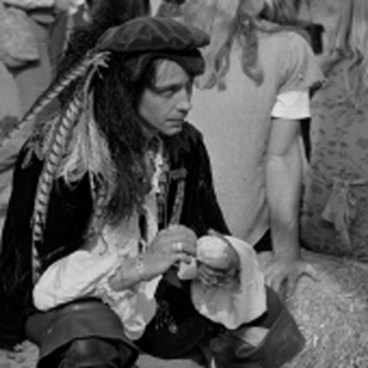
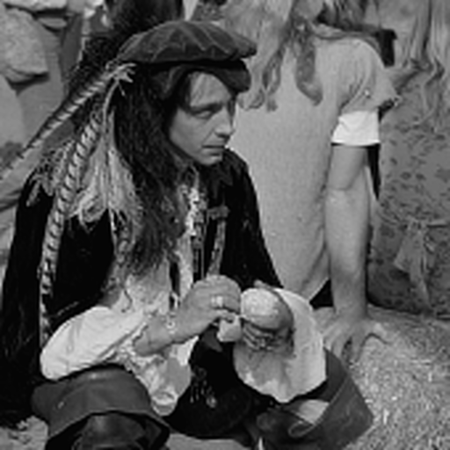

Slide 10
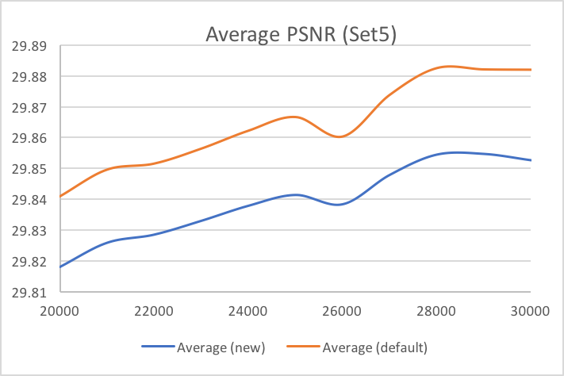
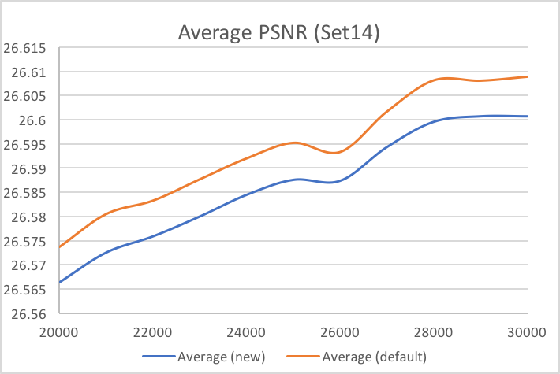
Results: Different Filter Setting #1
Change the number of filters:
1st CNN layer: 64 -> 32 * 9x9
2nd CNN layer: 32 -> 16 * 1x1
quite close results
0.01 ~ 0.03 dB less
but less training time
Default: ~ 2.0h
New: ~ 1.4h
(30,000 iterations)

Slide 11






Slide 12
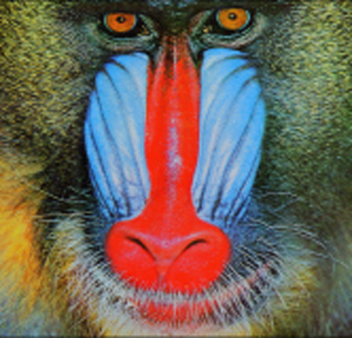


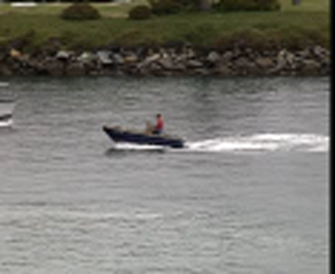




Slide 13
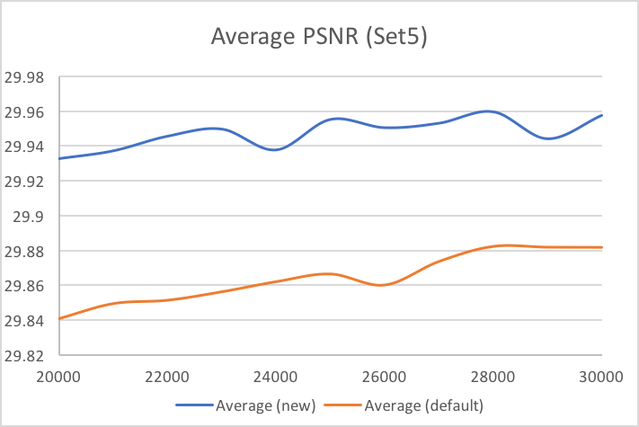
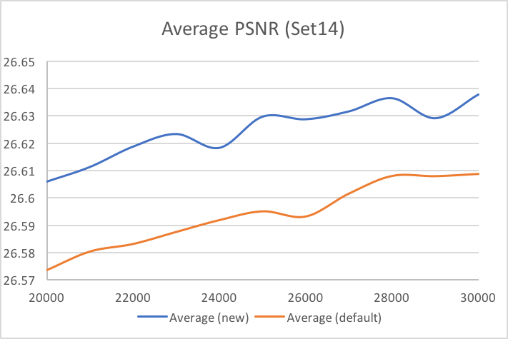
Results: Different Filter Setting #2
Change the number and size of filters:
1st CNN layer: 64 * 9x9 -> 32 * 11x11
2nd CNN layer: 32 -> 16 * 1x1
slightly better results
0.03 ~ 0.08 dB more
but much less training time
Default: ~ 2.0h
New: ~ 1.0h
(30,000 iterations)

Slide 14

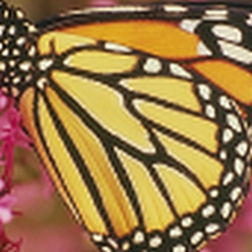




Slide 15
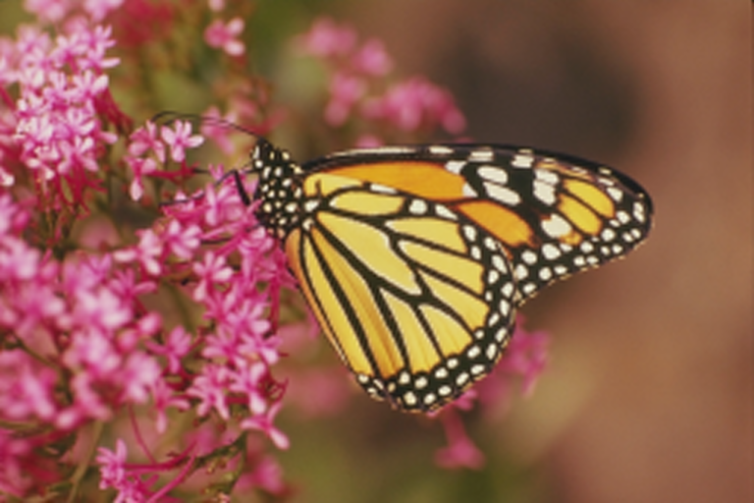



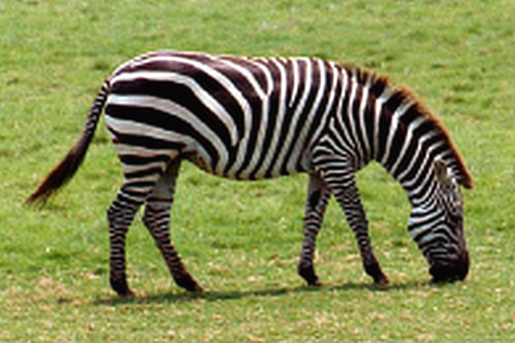




Slide 16
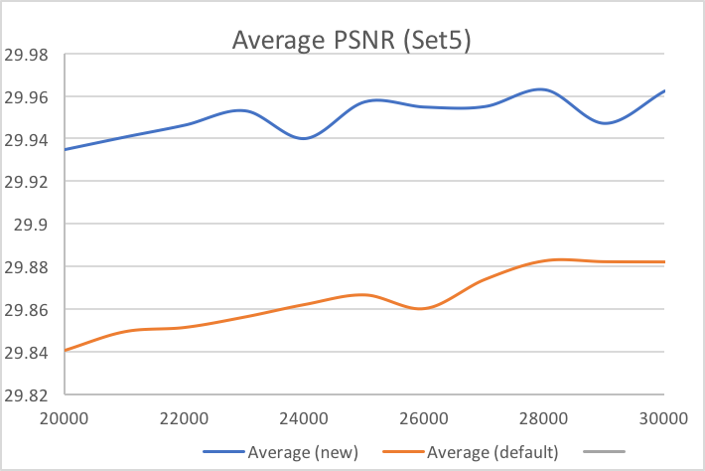
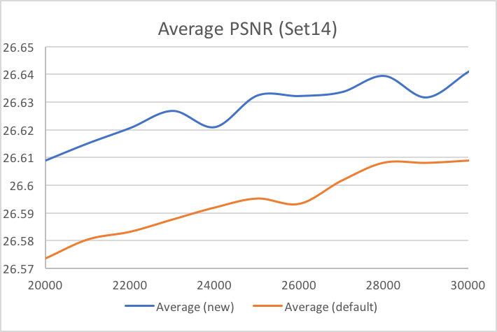
Results: Different Filter Setting #3
Change the size of filters:
1st CNN layer: 64 * 9x9 -> 11x11
slightly better results
0.03 ~ 0.08 dB more
similar training time
Default: ~ 2.0h
New: ~ 2.1h
(30,000 iterations)
not outperform Setting #2
but use more training time

Slide 17

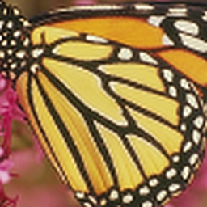




Slide 18





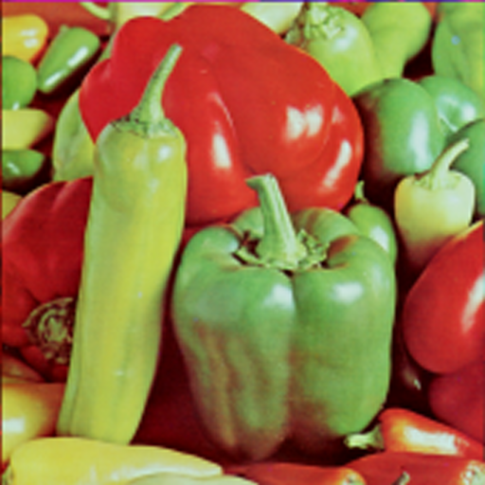


Slide 19
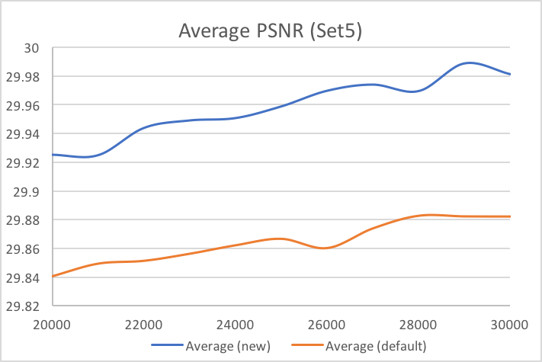
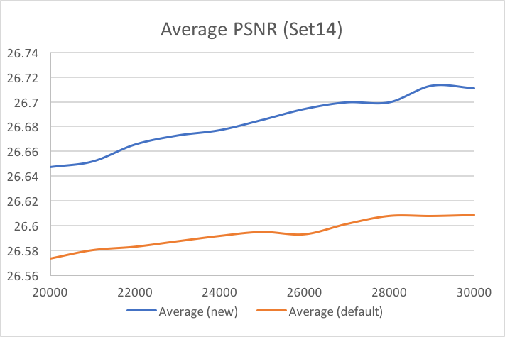
Results: Different Filter Setting #4
Change the number and size of filters:
1st CNN layer: 64 * 9x9 -> 32 * 13x13
2nd CNN layer: 32 -> 16* 1x1
better results than previous settings
around 0.1 dB more
much less training time
Default: ~ 2.0h
New: ~ 1.0h
(30,000 iterations)

Slide 20



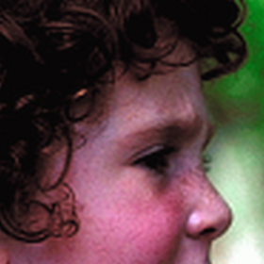


Slide 21







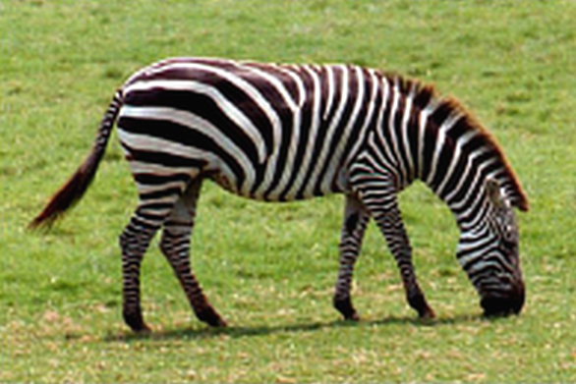



Slide 22
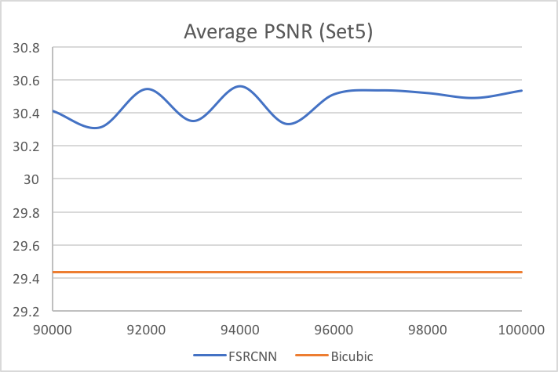
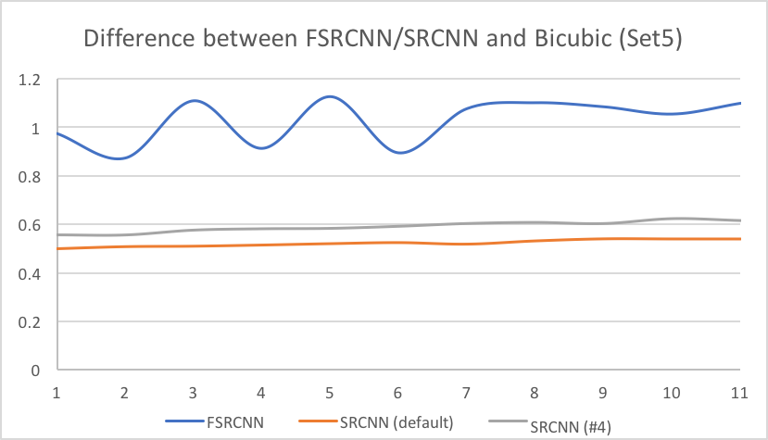
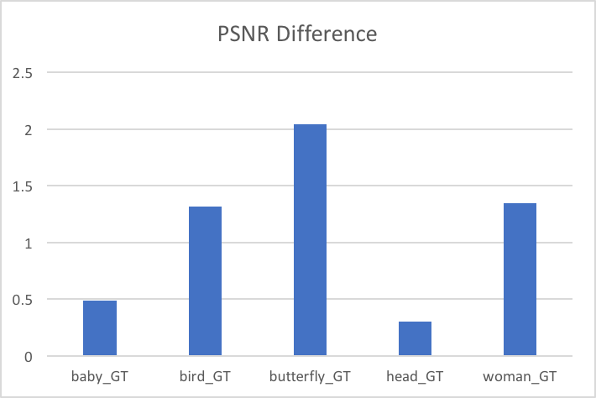
Results: FSRCNN
slightly better results and much faster (~ 1.6 hr for 10,000 iterations)
 | FSRCNN | Bicubic
baby_GT | 33.39 | 32.90
bird_GT | 33.06 | 31.74
butterfly_GT | 25.02 | 22.98
head_GT | 32.30 | 32.01
woman_GT | 28.89 | 27.54

Slide 23
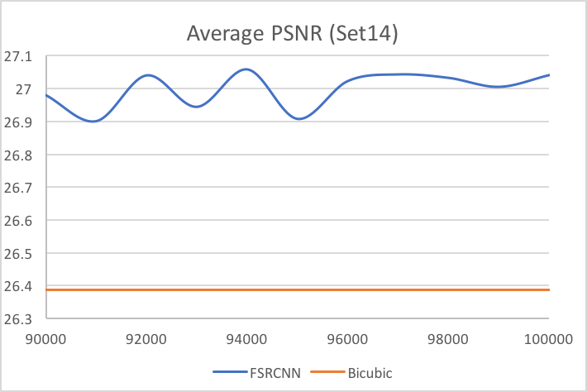
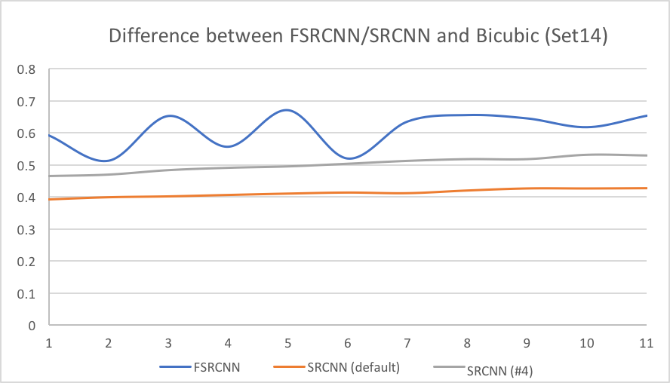
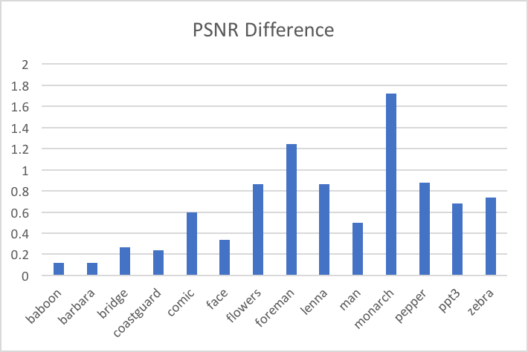
Results: FSRCNN
slightly better results and much faster (~ 1.6 hr for 10,000 iterations)
 | FSRCNN | Bicubic |  | FSRCNN | Bicubic
baboon | 21.77 | 21.65 | foreman | 30.73 | 29.49
barbara | 25.17 | 25.05 | lenna | 31.09 | 30.23
bridge | 24.74 | 24.47 | man | 26.35 | 25.85
coastguard | 25.48 | 25.25 | monarch | 30.12 | 28.40
comic | 22.55 | 21.95 | pepper | 31.56 | 30.69
face | 32.30 | 31.96 | ppt3 | 23.03 | 22.34
flowers | 27.21 | 26.35 | zebra | 26.48 | 25.75

Slide 24
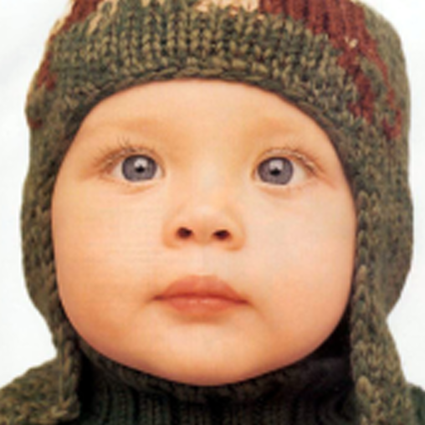
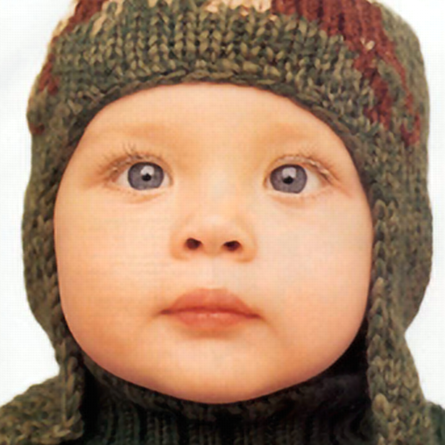

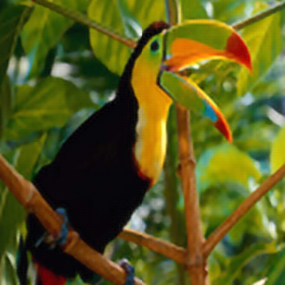
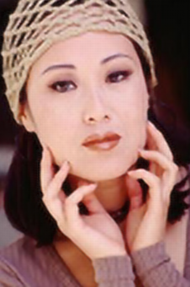


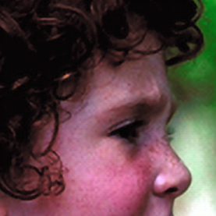
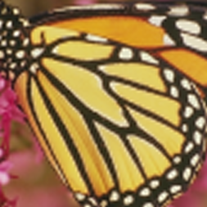
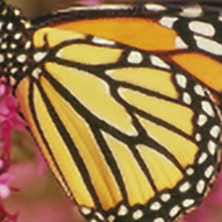

Slide 25
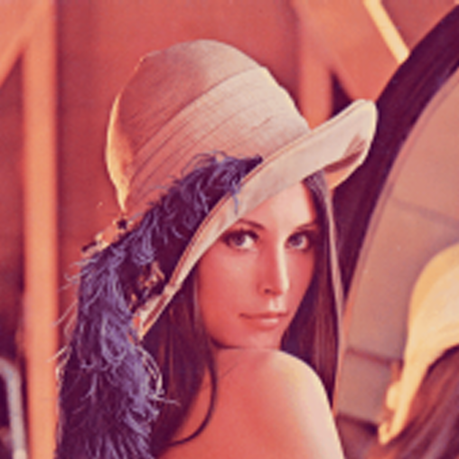
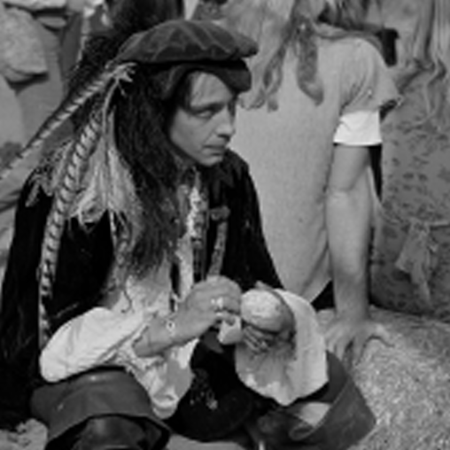


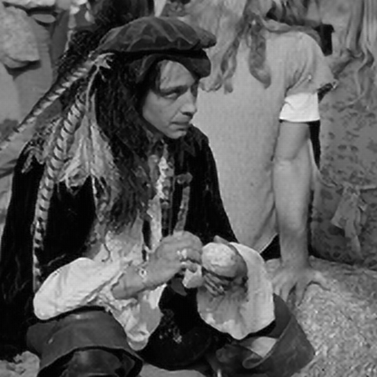
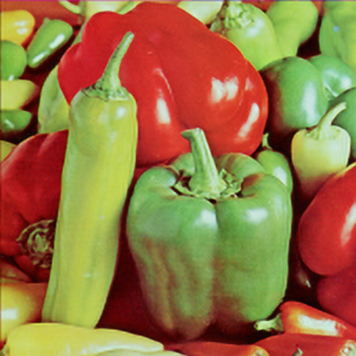


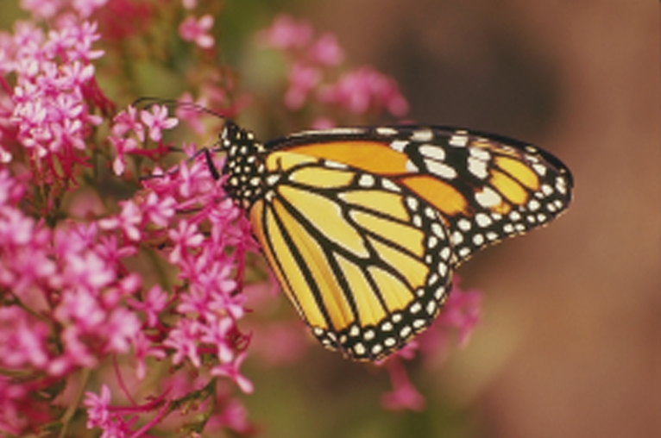


Slide 26
Style Transfer
Objective:
To extract Content Targets and Style Targets, and to search for an optimal input image that produces similar response as the content and style targets
Extract Content/Style Targets
Calculate Loss/Gradients
Minimize the Loss

Slide 27
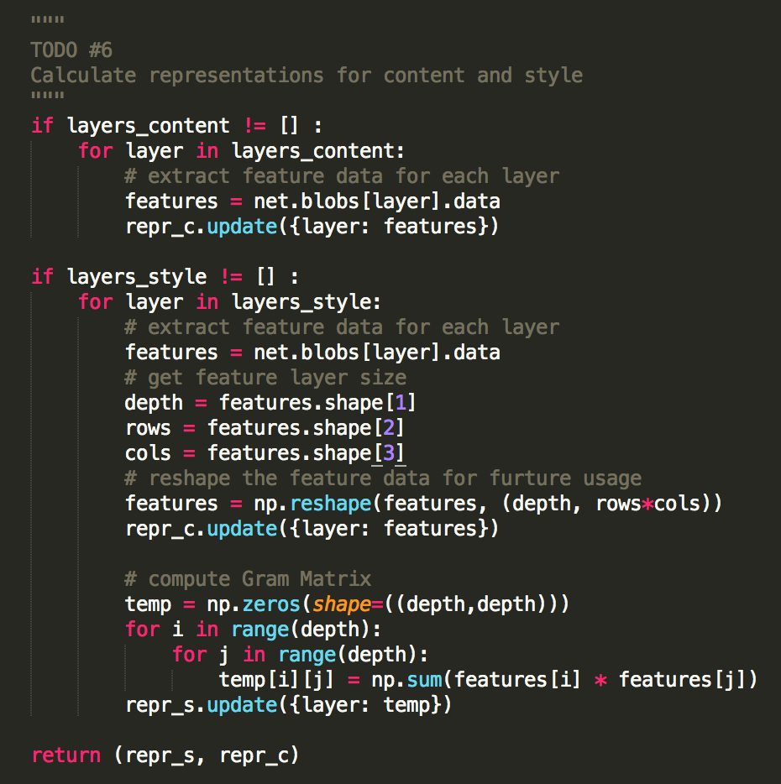

Calculate Content Target and Style Target

Slide 28






Calculate Loss and Gradients

Slide 29

Calculate Loss and Gradients

Slide 30



Results

Slide 31



Results

Slide 32



Results

Slide 33



Results

Slide 34



Results 1: Different # of Iterations

Slide 35



Results 1: Different # of Iterations

Slide 36





Results 2: Different Combinations of Style Targets

Slide 37





Results 2: Different Combinations of Style Targets

Slide 38




Results 2: Different Combinations of Style Targets

Slide 39




Results 2: Different Combinations of Style Targets

Slide 40
Efficiency
mainly relate to the size of content image, the number of iterations, and the layers in style targets
For 640*427 content image:
32 iterations: around 1000 s
512 iterations: around 3 hr
With only one layer in style target:
32 iterations: around 400 s

